Slide 1
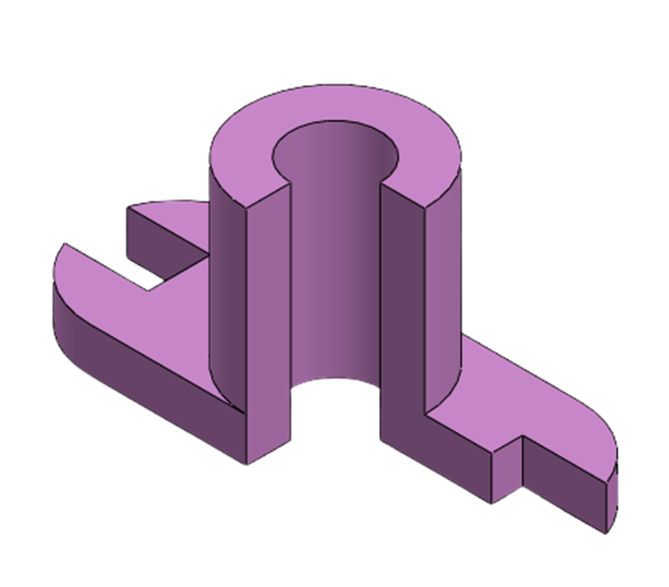
Orthographic Sectional Views
Prepared by:
Er. Bibek Magar
BE in Automobile Engineering
IOE, Thapathali Campus
bibek.magar@thc.tu.edu.np

Slide 2
Sectional Views
Machine parts have external as well as internal details. The internal features are not visible in an exterior view and if they are to be shown in the drawing they are required to be drawn by short dashed hidden lines. If there are many such details represented by hidden lines, the description becomes confusing as the lines of one detail overlap with those of other details.
To avoid this confusion, the objects are assumed to have been cut through at important points and the sectional views are drawn so that these internal features can be shown by outlines.
For machine parts to be manufactured, the complete information about each and every detail—whether it is of the internal or the external portion of the machine part—is required to be given in the drawing. Sectional views, therefore, are unavoidable in industrial drawings.
In this chapter, the discussion is limited to full- and half-sectional views along with the revolved, rotated, removed, and off set sections.

Slide 3
Types of Sectional Views
Full-Sectional View
Half-Sectional View
Auxiliary Sectional View
Offset Sectional View
Revolved/ Aligned Sectional View
Rotated Sectional View
Removed Sectional View

Slide 4
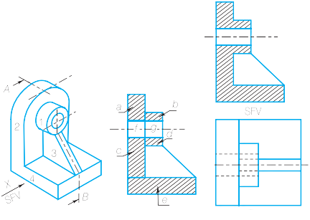
Full-Sectional View

Slide 5
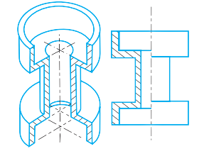
Half-Sectional View

Slide 6
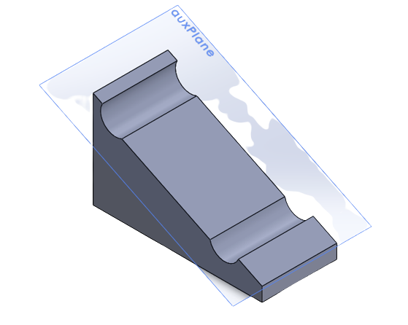
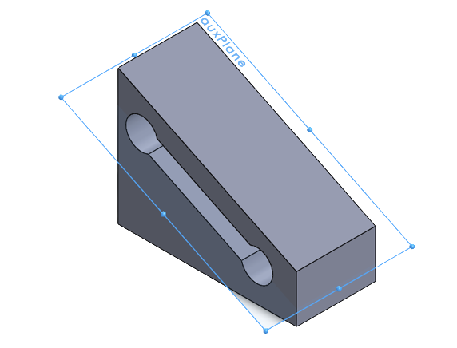
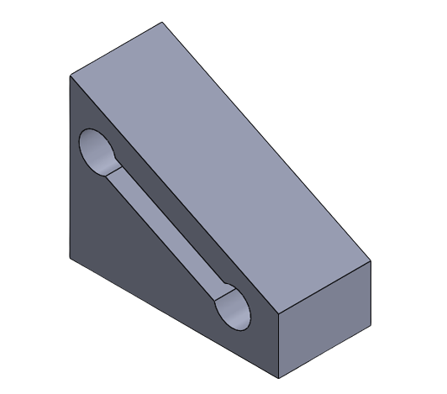
Auxiliary Sectional View

Slide 7
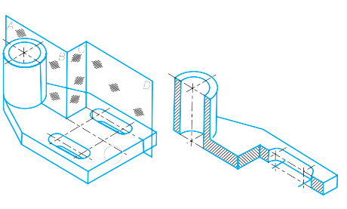
Offset Sectional View

Slide 8
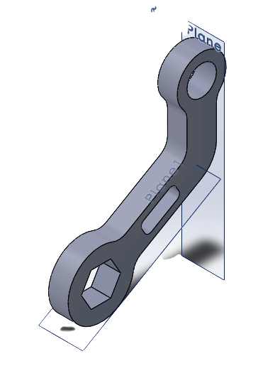
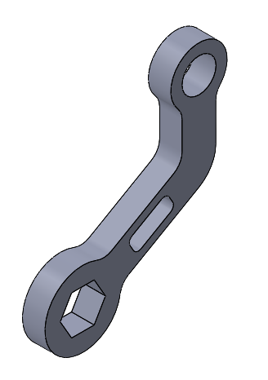
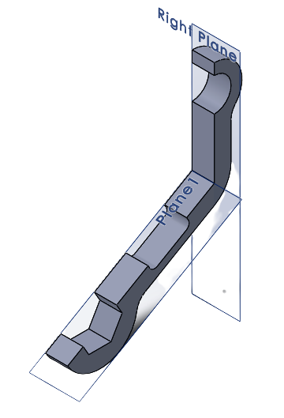
Revolved/ Aligned Sectional View

Slide 9
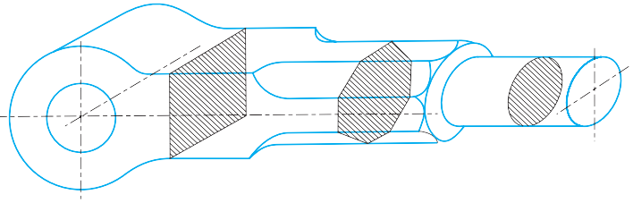
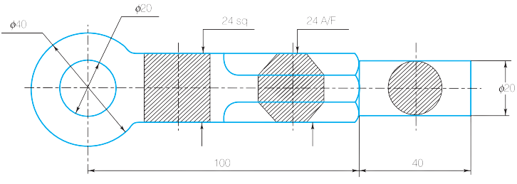
Rotated Sectional View

Slide 10
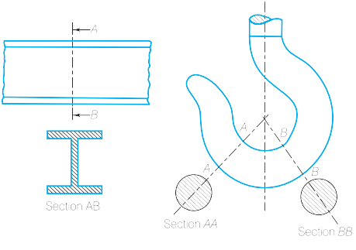
Removed Sectional View

Slide 11
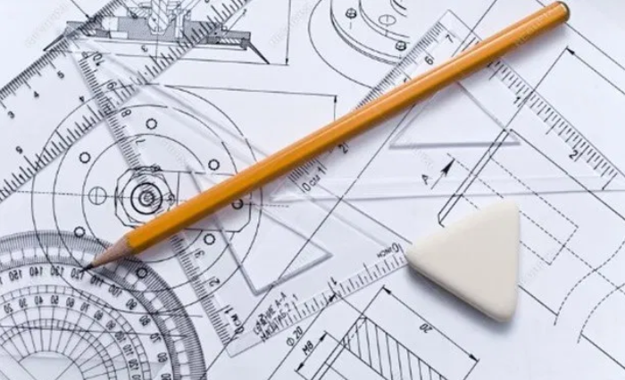
Solved Examples:

Slide 12
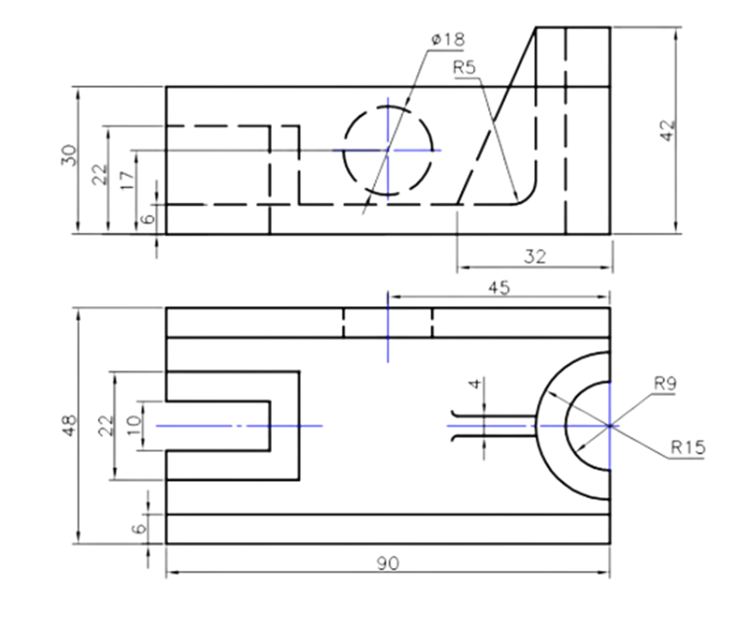
1) Draw full sectional front view.

Slide 13
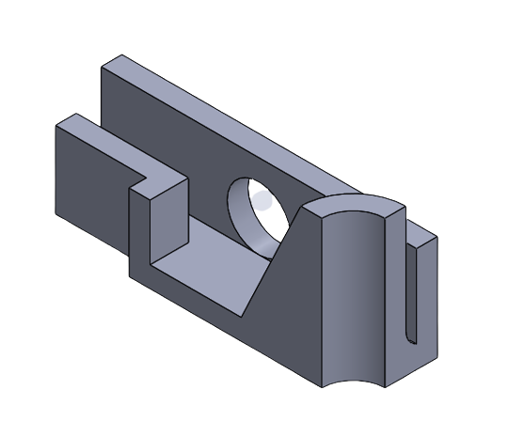
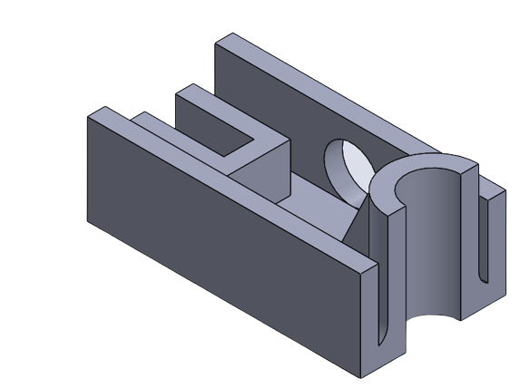
3D Visualization:

Slide 16
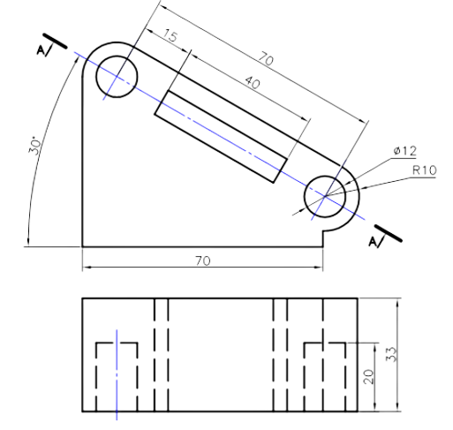
2) Draw sectional view at A-A’.

Slide 17
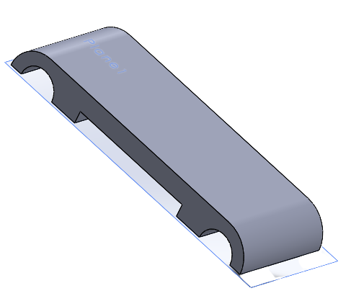
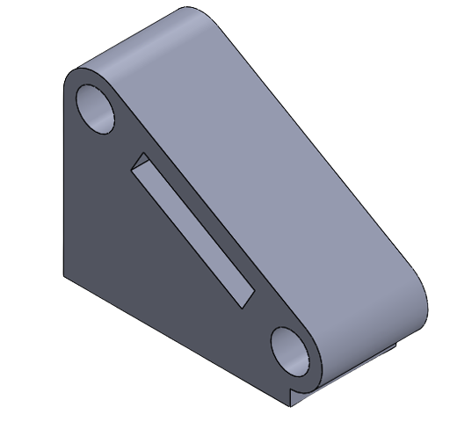
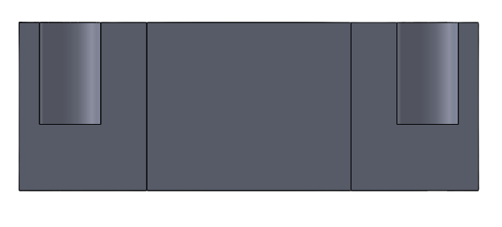
3D Visualization:

Slide 20
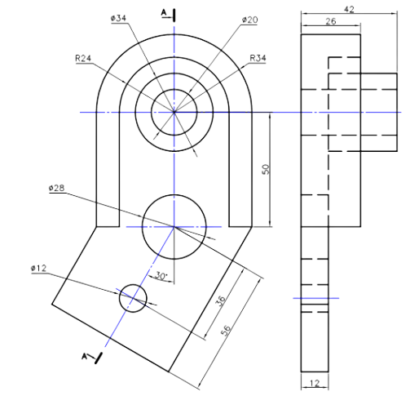
3) Draw revolved section view at A-A.

Slide 21
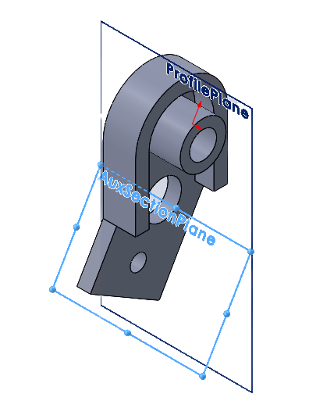
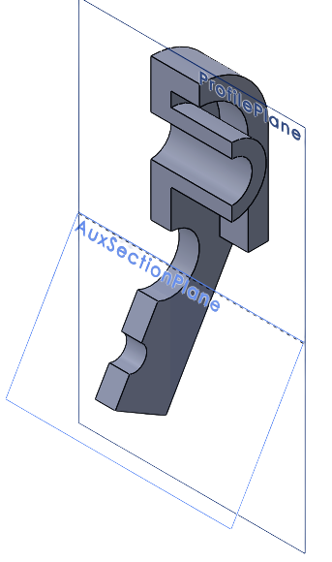
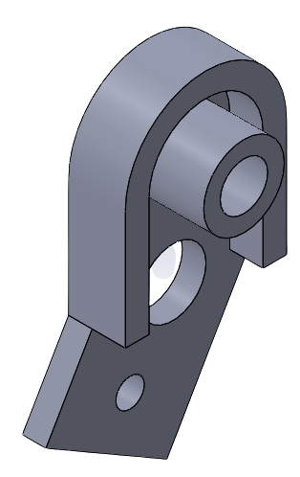
3D Visualization:

Slide 22
A
A

Slide 24
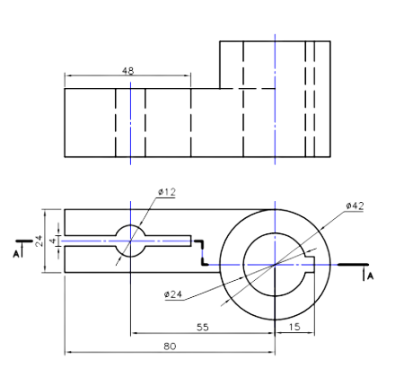
4) Draw offset section for A-A in figure.

Slide 25
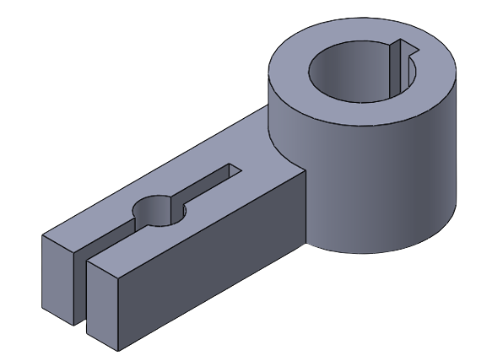
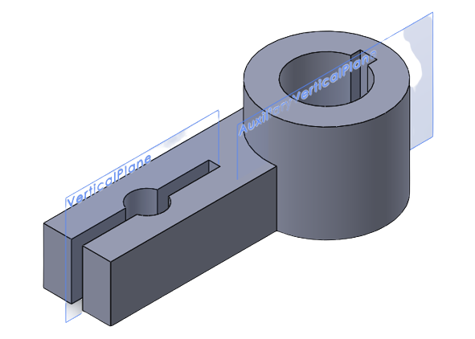
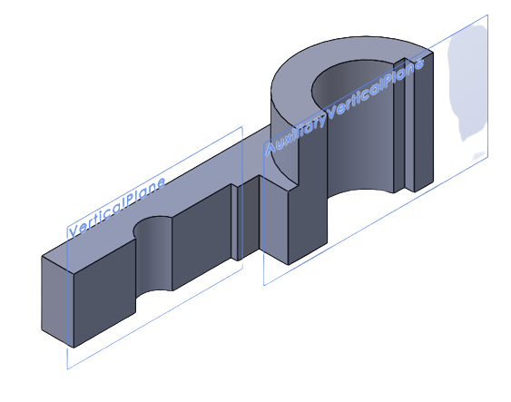
3D Visualization:

Slide 27
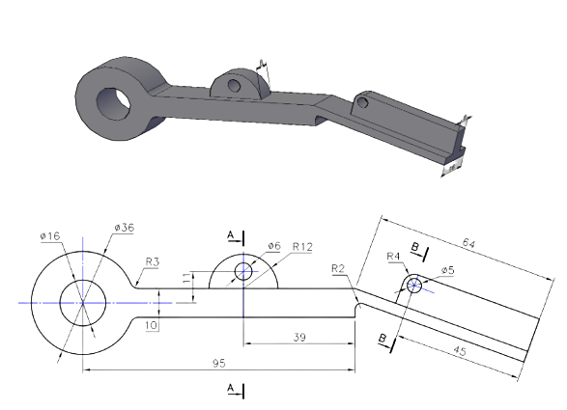
5) Draw the removed and rotated section at A- A and B-B.

Slide 28
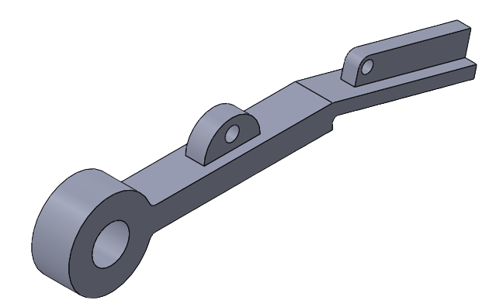
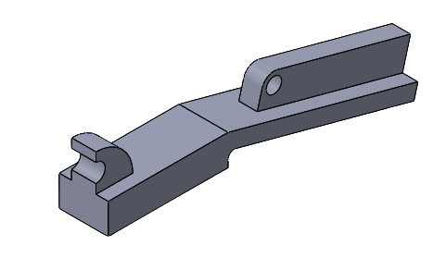
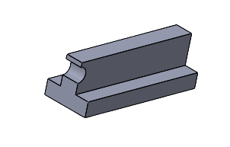
3D Visualization:

Slide 29
A
B
B
A

Slide 30
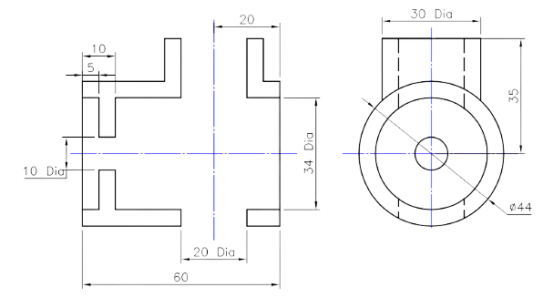
6) Complete the front sectional view including missing lines and intersection curves.

Slide 31
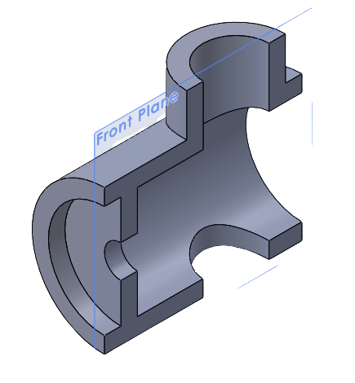
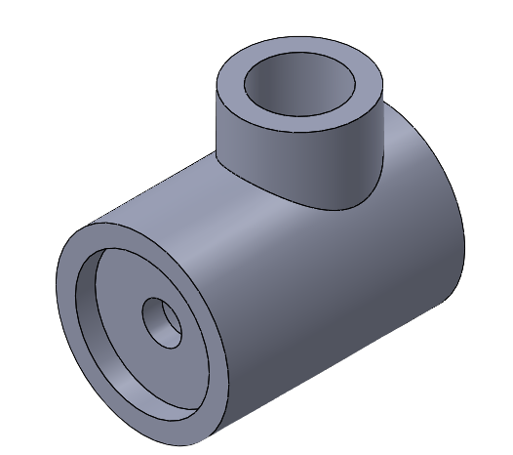
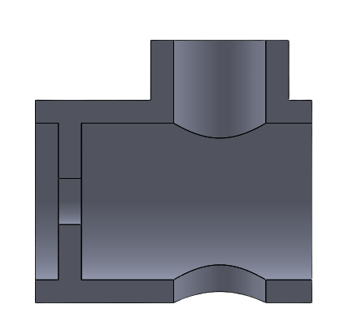
3D Visualization:

Slide 34
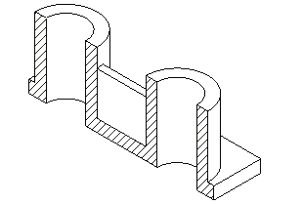
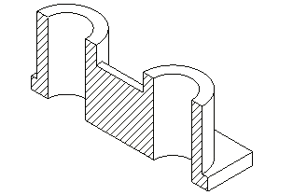
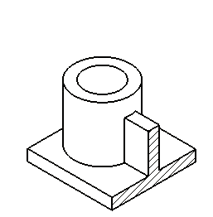


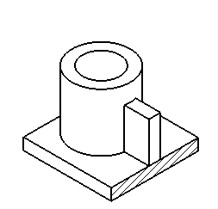
Conventional Practice in Sectional View
1) Omit the section lines for Rib, Web, and other thin supporting structural parts if the cutting plane is passing longitudinally ( along the length of the supporting structure), however include the section lines if the cutting plane is passing transversally ( perpendicular to the length of the supporting structure).

Slide 35
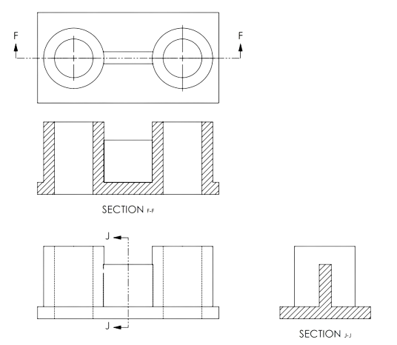
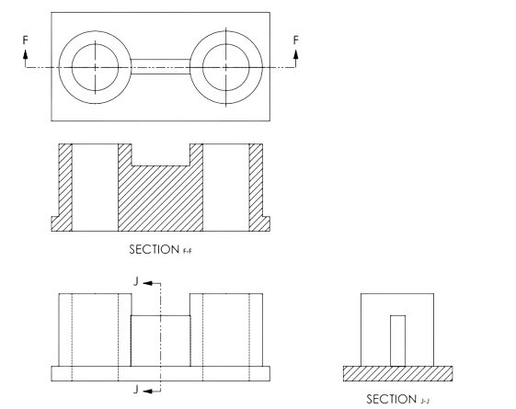

Slide 36
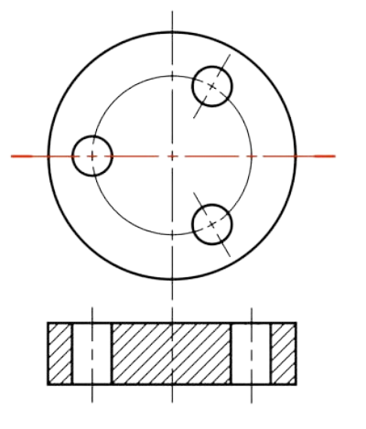
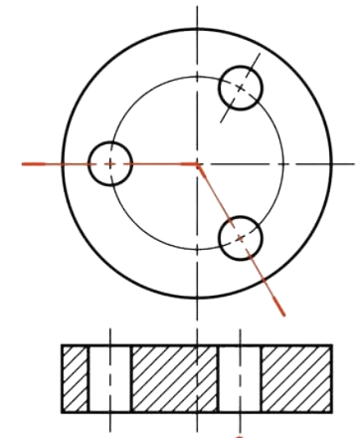
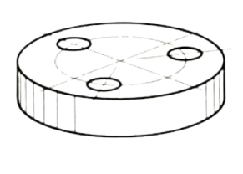
2) For components of a part which exhibit radial symmetry, using true projection yields an unpleasant/ asymmetrical view, so we use aligned view to represent radial symmetry in the orthographic views.
Radially Symmetrical Holes

Slide 37
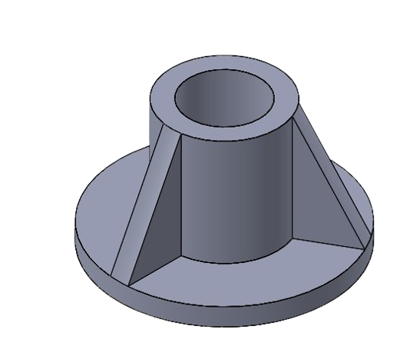
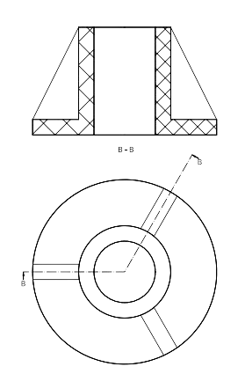
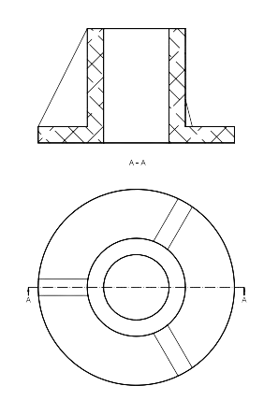
Radially Symmetrical Ribs

Slide 38
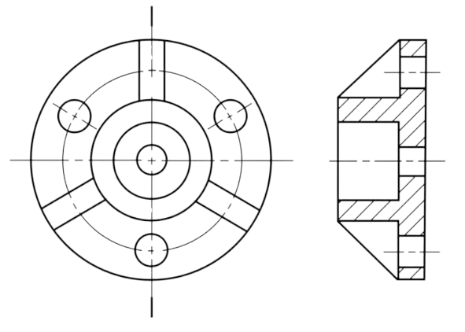
Radially Symmetrical Holes and Ribs

Slide 39

Spokes and Keyway

Slide 40

Radially Symmetrical Lugs

Slide 41

7) Draw sectional front view and top view of the object given below. Use conventions for radially arranged holes, ribs, and spokes.

Slide 44


